Slide 1
An introduction to Javascript
D3 training – 4

Slide 2
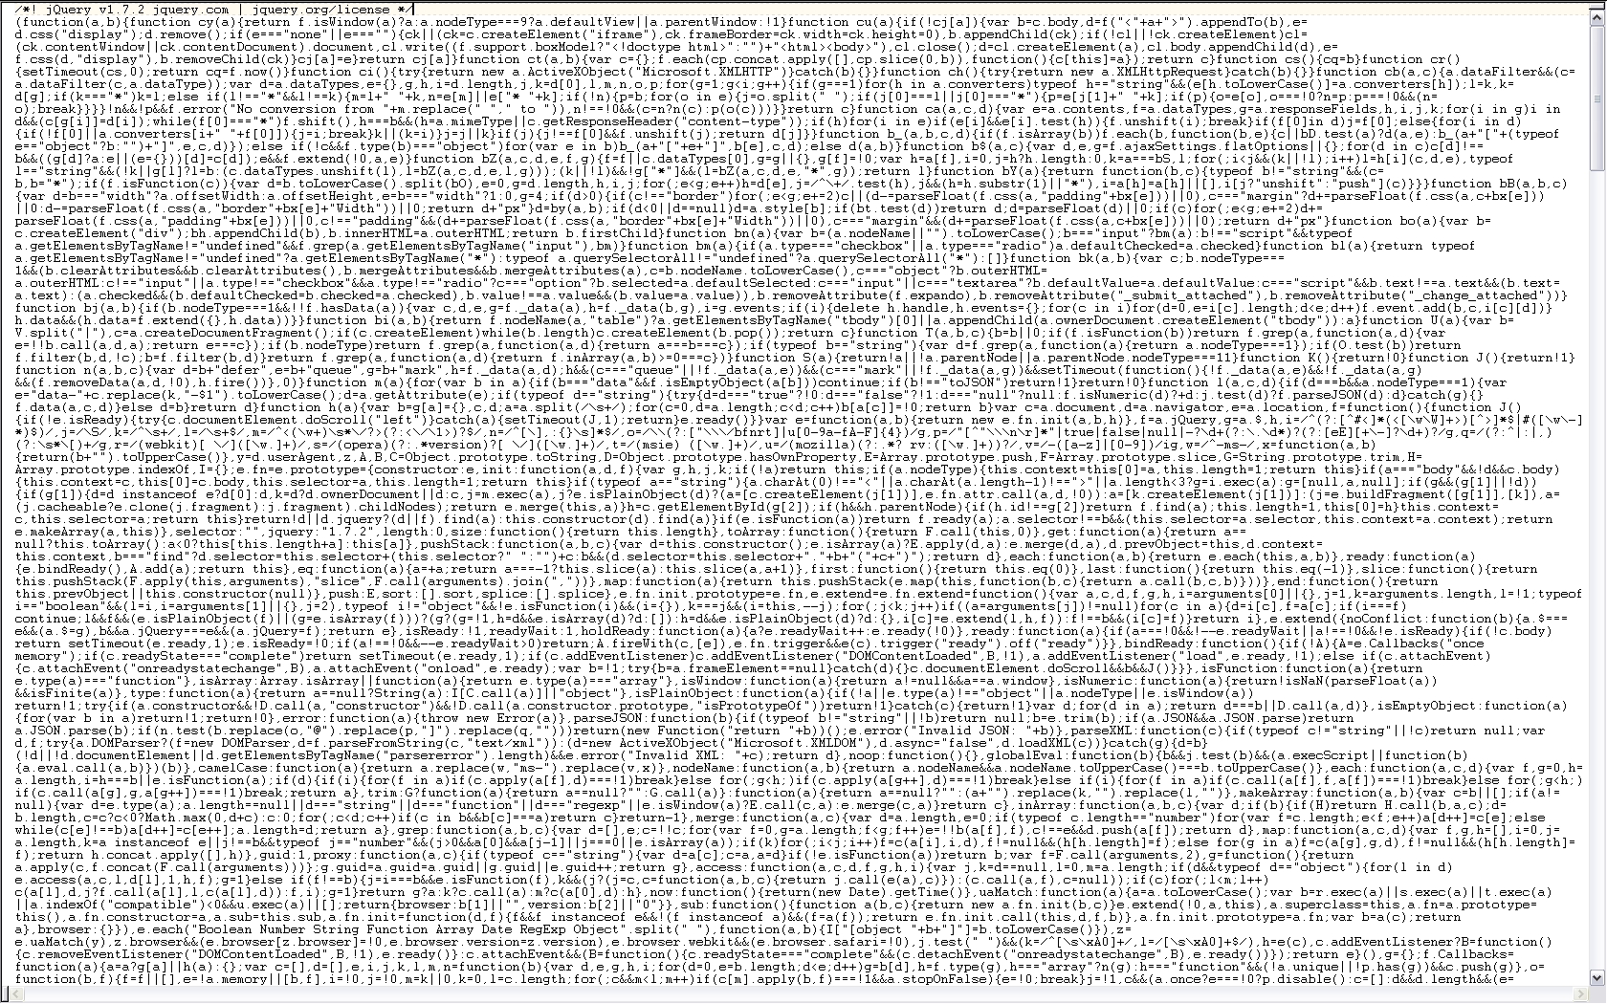
OMG it's a programming language

Slide 3
Yes, and
It is a very versatile (and so very extensive) language.
Beyond the language proper, there is an ever evolving number of libraries and extensions…
Contrary to HTML, CSS, SVG where you really need to know only enough to look up what you need, in d3 you are actually writing javascript

Slide 4

Yes, but
With d3, you only need a very small subset of the language
So there is not a lot of javascript you must know.
(though honestly: knowing more helps)

Slide 5
Javascript, demystified
Javascript is really a series of statements or instructions.
Statement1;
Statement2;
Statement3;
The statements are executed in sequence.

Slide 6
Javascript, demystified
Javascript is really a series of statements or instructions.
Statement1;
Statement2;
Statement3;
The statements are executed in sequence.
They end with a semi-colon (optional, but recommended).

Slide 7
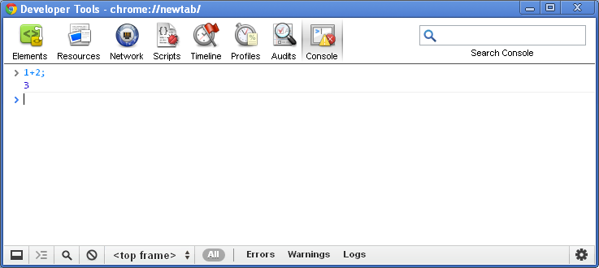
Let's do things with javascript!
Statements need not to be complicated.

Slide 8
Variables
In order to get most things done with javascript, you need variables.
Variables allow your program to remember values.
To create a variable, you can just write var myVariable=0;

Slide 9
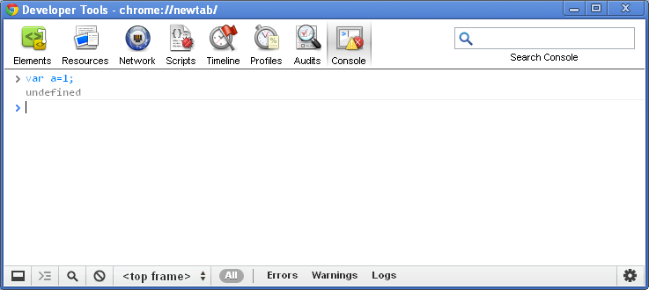
Variables

Slide 10
Variables
var myVariable=0; The var is optional (but recommanded). You can assign any kind of value to any variable:
myVariable = "Hello world"; // String
myVariable = 123.45; // number
myVariable = true; // boolean (true or false)
myVariable = null; // nothing

Slide 11
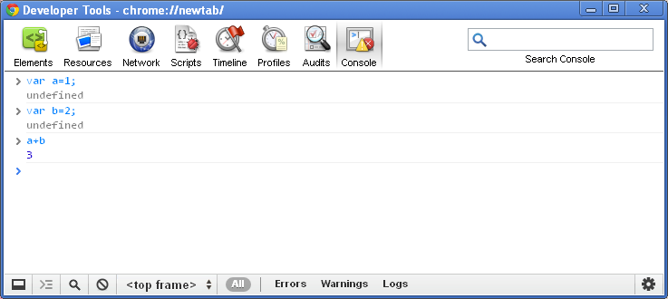
Using variables
It's easier to use variables than literals.

Slide 12
Everything is worth something
So far, we assigned literals (ie numbers spelled out, strings) to variables var a=123;
But in javascript, even statements have values.
1+2 // worth 3. Duh
var a=123 // worth 123.
1<2 // worth true

Slide 13
Some simple operations
+, -, /, * work as expected between numbers! 1 + 2; // 3 3 * 4; // 12 12 / 4; // 3
+ with a string concatenates (joins both sides).
"hello "+"world"; // "hello world"
"hello "+1; // "hello 1"

Slide 14
Objects
Objects are a special kind of variables in javascript.
Think of it as way to group information that belongs together.
Technically, objects are a list of keys with properties.
var myObject={
key1:property1,
key2:property2,
…,
keyn:propertyn}

Slide 15
Objects
var buddy={
species:"dalmatian",
age:7,
gender:"male"
};
var coco={ species:"pomeranian",
age:4,
gender:"female"
};

Slide 16
Objects
Then, to retrieve a value, one uses the . (dot) operator.
myObject.key1 // property1
buddy.age // 7
coco.species // "pomeranian"
Or, alternatively, [ ] square braces:
buddy["gender"] // male

Slide 17
Arrays
Arrays are another special kind of variable.
It is a way of representing a series of similar items.
var prime=[2, 3, 5, 7, 11, 13, 17, 19, 23, 29, 31, 37, 41, 43, 47];

Slide 18
Arrays
Everything can go in an array! var a=[1,2,3]; // numbers var b=["hello","world"]; // strings var c=[buddy, coco]; // objects var d=[a,b,c]; // other arrays
We retrieve values with the [ ] square braces.
a[0]; // 1
b[1]; // "world"
Array indices start at 0.

Slide 19
What we know so far
Javascript programs are a series of statements.
Variables are used to remember values:
A single value var a=1;
A group of values var buddy={type:"dog",age:7};
A series of values
var prime=[2,3,5,6,11];

Slide 20
Functions
Normally, javascript executes all statements in sequence.
There are a number of ways to go beyond that, including functions.
Statement 1;
Statement 2;
Statement 3;

Slide 21
Functions
A function is a package of code that can be called.
When you call a function, the system executes the function code, then goes back to where it was called.
Statement 1;
myFunction();
Statement 3;
Statement 4;
Statement 5;
Statement 6;

Slide 22
Functions
A function is a great way to avoid repeating code. Here's an example: function sq(x) {return x*x;}
Now each time I want to square a number I can write: sq(4.1368) // instead of 4.1368*4.1368
Functions are used extensively in d3.

Slide 23
Anatomy of a function
The function keyword introduces the function.
Next comes the name of the function. The camelCase notation is prefered. In parentheses is the argument to the function. Functions may or may not require arguments.
Next comes the opening brace.
Statements follow, which are executed in normal order.
The function may or may not return a value.
In order to call the function, we just write its name with an argument between parentheses if needed.
function doStuff(x) {
statement1;
statement2;
statement3;
return result;
}
doStuff(x);

Slide 24
Functions
A function may return a value with the statement return.
If so, its value is what is returned:
sq(2)+2; // 6

Slide 25
Methods
Methods are like functions, but they apply to certain type of objects.
Methods are called with the . notation:
"hello world".length()

